Slide 1
COR2 Catalog
Instructions

Slide 2
Name:
temporary9
Purpose:
CMEs Speed determination for COR2 data
Input Parameters:
filename - MVI file name
inRadius - Radius of the circumference (Solar radius)
Keyword Parameters:
startTime - Start time ‘yyyy-mm-dd hh:mm:ss’
endTime - End time ‘yyyy-mm-dd hh:mm:ss’
xCen - Projection of the center on x-axis (pixel)
yCen - Projection of the center on y-axis (pixel)
angRange - Angle range [0.,360.]
SampleTime - Sample time (sec.)
runDiff - Running Difference
Called routines:
Clickjmap_cor2_test.pro
COR2Record.pro
Calling Sequence:
temporary9, filename, inRadius [,startTime=startTime, endTime=endTime, $
xCen=xCen, ycen=ycen, angRange=angRange, $
sampleTime=sampleTime, runDiff=runDiff ]
Calling Example:
temporary9, 'C:\sdodata\20090826\T_COR2_A_ratio.mvi',4
temporary9, '/Volumes/Disk1/WorkingOn/Teresa/MVIs/T_COR2_A_ratio.mvi', 4

Slide 3
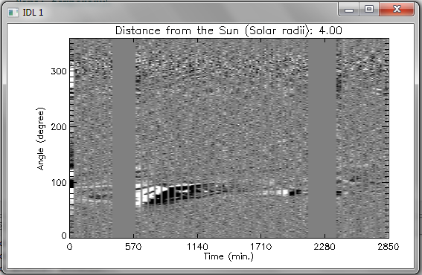
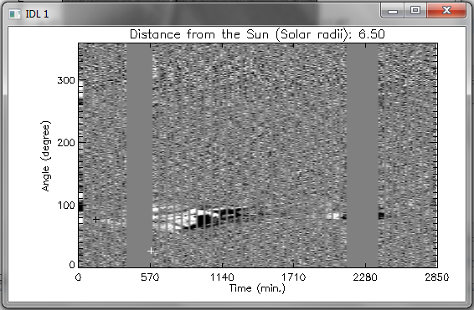
Window: Angle vs. Time
Inside the plot:
Left click to test points (the result of the test can be observed in Window 0)
Middle click to select the previous time
Middle click to select the lower angle
Middle click to select the higher angle
Right click to select the position angle (direction of propagation)
Outside the plot
Left side (Orange region):
Left click to increase the distance from the Sun (+0.5 Solar Radii)
Right click to decrease the distance from the sun (-0.5 Solar Radii)
Right side (Green region):
Left click to open the Color table

Slide 4
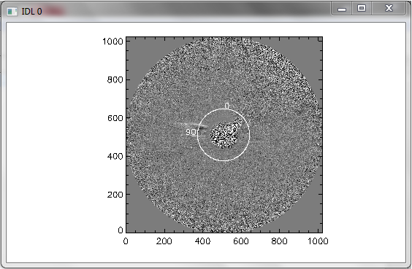
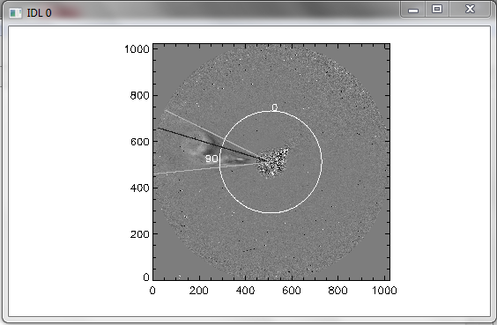
Window: COR2 Disc
This plot presents the result of the changes in the COR2 frames before and after the modifications in the Angle x Time plot.

Slide 5
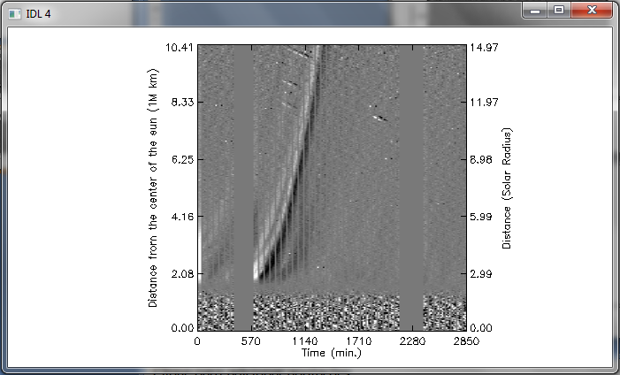
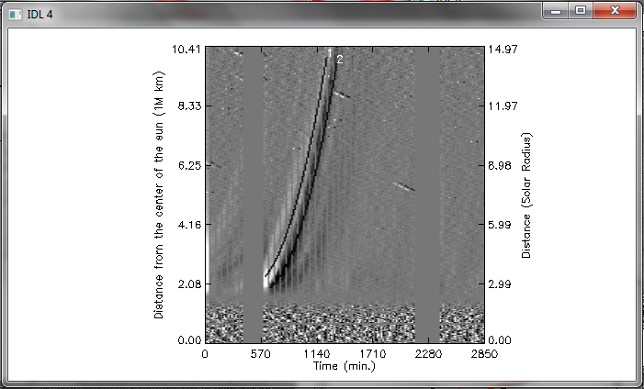
Window: HT map
Inside the plot:
Left click to test points (the result of the test can be observed in Window COR2 Disc 2)
Middle click to start select the points for the curve
Left click to select the points for the curve
Right click to finish the selection
Write the Remark in the command line
Select the 2nd curve (go to step 1) or Right click to finish
Outside the plot
Left side (Orange region):
Left click to reset (go back to the window Angle vs. Time)
Right side (Green region):
Left click to open the color Table

Slide 6
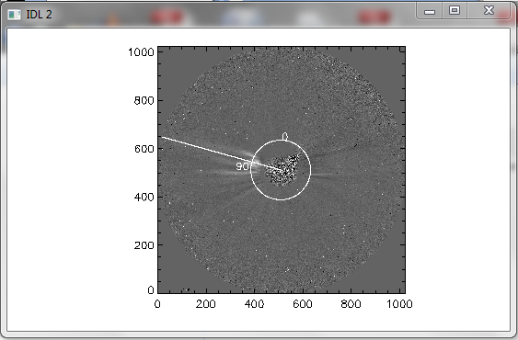
Window: COR2 Disc 2
Result of the tests in the window HT map

Slide 7
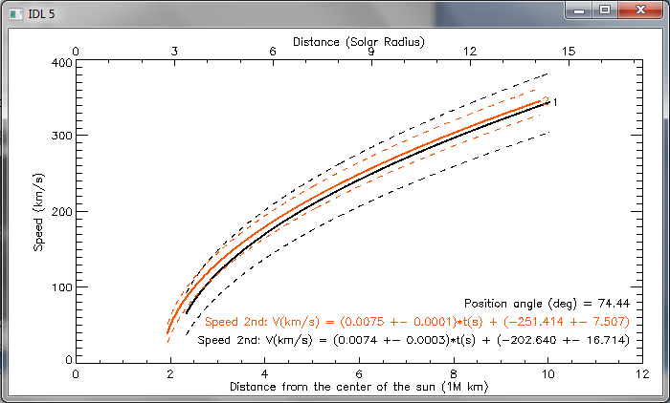
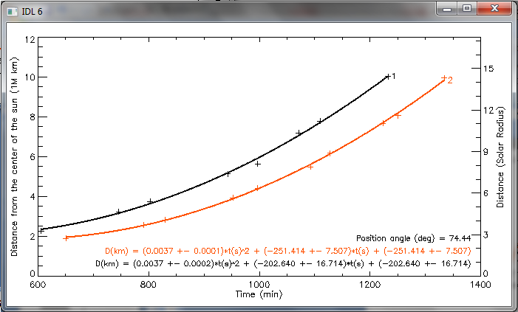
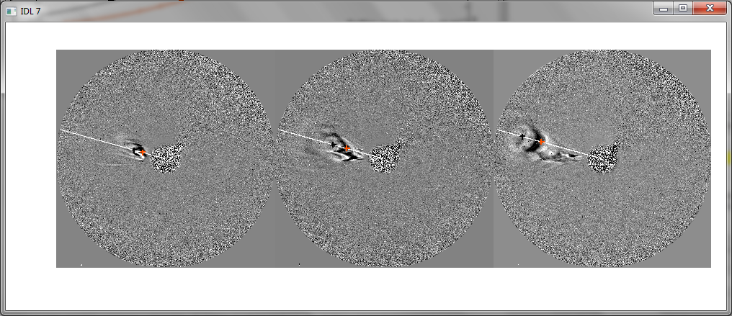
Window: Speed vs. Distance
Window: Distance vs. Time
Window: Image sequence

Slide 8
Text file output
#MVI_FILE: MVI file name
#PLOT_START_TIME: Start time of the plot
#FILENAME_START_TIME: File corresponding Start Time
#PLOT_END_TIME: End time of the plot
#FILENAME_END_TIME: File corresponding End Time
#DETECTOR: Name of the detector
#CDELT1: CDELT1 from the header
#RSUN: Radius of the Sun in arcsec from the header
#N_FILES: Number of files
#OBSERVER: Name of the observer
#IMAGE_TYPE: Name of the treatment of the image
#PRE-EVENT_TIME: Time previous to the event
#PRE-EVENT_FILENAME: File name of the pre event Time
#POSITION_ANGLE: Position angle selected
#ANGULAR_WIDTH_POSI1: First selected angle to determinate the angular width
#ANGULAR_WIDTH_TIME1: Time of the first selected angle
#ANGULAR_WIDTH_FILE1: File corresponding Time 1
#ANGULAR_WIDTH_POSI2: Second selected angle to determinate the angular width
#ANGULAR_WIDTH_TIME2: Time of the second selected angle
#ANGULAR_WIDTH_FILE2: File corresponding Time 2
#ANGULAR_WIDTH: Angular width
#DIST_SUN: Distance from the Sun (where ang. width was selected)
#ATTACHED_IMAGES_1: Name of an attached image
#ATTACHED_IMAGES_2: Name of an attached image
#ATTACHED_IMAGES_3: Name of an attached image
#ATTACHED_IMAGES_4: Name of an attached image
#ATTACHED_IMAGES_5: Name of an attached image
#COMMENT: Comment about the event in the period
#
#CURVE_N: Id of the curve
#DATE-OBS: Date of the first click
#TIME-OBS: Time of the first click
#1ST_ORDER_SPEED: Speed equation (1st order)
#1ST_ORDER_SPEED: V1st(km/s) = A1 +- Ea1
#A1: A1 variable
#Ea1: Error of A1
#2ND_ORDER_SPEED: Speed equation (2nd order)
#2ND_ORDER_SPEED: V2nd(km/s) = (A2 +- Ea2)*t(s) + (B2 +- Eb2)
#A2: A2 variable
#Ea2: Error of A2
#B2: B2 variable
#Eb2: Error of B2
#N_POINTS: Number of clicked points
#REMARK: Remark of the curve
# HEIGHT(1M Km) HEIGHT(SR) DATE TIME COL(px) ROW(px) FILENAME

Slide 9
#MVI_FILE: T_COR2_A_ratio.mvi
#PLOT_START_TIME: 2009-08-25 00:24:00
#FILENAME_START_TIME: 20090825_002400_04c2A.fts
#PLOT_END_TIME: 2009-08-26 23:54:00
#FILENAME_END_TIME: 20090826_235400_04c2A.fts
#DETECTOR: COR2
#CDELT1: 29.40
#RSUN: 997.77
#N_FILES: 122
#OBSERVER: Name
#IMAGE_TYPE: RUNNING DIFF
#PRE-EVENT_TIME: 2009-08-25 04:24:00
#PRE-EVENT_FILENAME: 20090825_042400_04c2A.fts
#POSITION_ANGLE: 76.28
#ANGULAR_WIDTH_POSI1: 97.69
#ANGULAR_WIDTH_TIME1: 2009-08-25 15:24:00
#ANGULAR_WIDTH_FILE1: 20090825_152400_04c2A.fts
#ANGULAR_WIDTH_POSI2: 60.22
#ANGULAR_WIDTH_TIME2: 2009-08-25 14:39:00
#ANGULAR_WIDTH_FILE2: 20090825_143900_04c2A.fts
#ANGULAR_WIDTH: 37.47
#DIST_SUN: 4
#ATTACHED_IMAGES_1: HT_AngleTime_20090825_002400.png
#ATTACHED_IMAGES_2: HT_DistanceTime_20090825_002400.png
#ATTACHED_IMAGES_3: Plot_SpeedDistance_20090825_002400.png
#ATTACHED_IMAGES_4: Plot_DistanceTime_20090825_002400.png
#ATTACHED_IMAGES_5: ImageSequence_20090825_002400.png
#COMMENT:
#
#CURVE_N: 1
#DATE-OBS: 2009-08-25
#TIME-OBS: 10:20:51
#1ST_ORDER_SPEED: V1st(km/s) = 195.209 +- 12.353
#1ST_ORDER_SPEED: V1st(km/s) = A1 +- Ea1
#A1: 195.209
#Ea1: 12.353
#2ND_ORDER_SPEED: V2nd(km/s) = (0.006 +- 0.000)*t(s) + (-118.333 +- 4.675)
#2ND_ORDER_SPEED: V2nd(km/s) = (A2 +- Ea2)*t(s) + (B2 +- Eb2)
#A2: 0.00555
#Ea2: 0.00008
#B2: -118.333
#Eb2: 4.675
#N_POINTS: 10
#REMARK: front
# HEIGHT(1M Km) HEIGHT(SR) DATE TIME COL(px) ROW(px) FILENAME
2.07 2.98 2009-08-25 10:24:00 40 101 20090825_102400_04c2A.fts
3.07 4.42 2009-08-25 12:54:00 50 150 20090825_125400_04c2A.fts
3.59 5.16 2009-08-25 14:24:00 55 175 20090825_142400_04c2A.fts
4.81 6.92 2009-08-25 15:54:00 62 235 20090825_155400_04c2A.fts
5.27 7.57 2009-08-25 16:39:00 65 257 20090825_163900_04c2A.fts
6.23 8.96 2009-08-25 17:54:00 70 304 20090825_175400_04c2A.fts
6.68 9.60 2009-08-25 18:24:00 72 326 20090825_182400_04c2A.fts
7.83 11.25 2009-08-25 19:39:00 77 382 20090825_193900_04c2A.fts
8.18 11.75 2009-08-25 20:24:00 79 399 20090825_202400_04c2A.fts
10.14 14.58 2009-08-25 21:54:00 86 495 20090825_215400_04c2A.fts
#
#CURVE_N: 2
#DATE-OBS: 2009-08-25
#TIME-OBS: 10:50:42
#1ST_ORDER_SPEED: V1st(km/s) = 195.261 +- 12.387
#1ST_ORDER_SPEED: V1st(km/s) = A1 +- Ea1
#A1: 195.261
#Ea1: 12.387
#2ND_ORDER_SPEED: V2nd(km/s) = (0.006 +- 0.000)*t(s) + (-188.777 +- 10.947)
#2ND_ORDER_SPEED: V2nd(km/s) = (A2 +- Ea2)*t(s) + (B2 +- Eb2)
#A2: 0.00629
#Ea2: 0.00018
#B2: -188.777
#Eb2: 10.947
#N_POINTS: 12
#REMARK: Dark region
# HEIGHT(1M Km) HEIGHT(SR) DATE TIME COL(px) ROW(px) FILENAME
1.56 2.24 2009-08-25 10:54:00 42 76 20090825_105400_04c2A.fts
2.34 3.36 2009-08-25 13:24:00 52 114 20090825_132400_04c2A.fts
2.75 3.95 2009-08-25 14:24:00 55 134 20090825_142400_04c2A.fts
3.69 5.30 2009-08-25 15:54:00 62 180 20090825_155400_04c2A.fts
4.49 6.45 2009-08-25 17:24:00 68 219 20090825_172400_04c2A.fts
5.68 8.16 2009-08-25 18:54:00 74 277 20090825_185400_04c2A.fts
6.25 8.98 2009-08-25 19:54:00 78 305 20090825_195400_04c2A.fts
7.21 10.37 2009-08-25 20:54:00 82 352 20090825_205400_04c2A.fts
7.60 10.93 2009-08-25 21:24:00 83 371 20090825_212400_04c2A.fts
9.02 12.96 2009-08-25 22:39:00 89 440 20090825_223900_04c2A.fts
9.34 13.43 2009-08-25 22:39:00 89 456 20090825_223900_04c2A.fts
10.10 14.52 2009-08-25 23:24:00 91 493 20090825_232400_04c2A.fts

Slide 10
Summary
Window: Angle vs. Time
Inside the plot:
Left click: Test points
Middle click*: Select Pre-event Time, Angle1 and Angle2
Right click: Select Position Angle
Left side:
Left click: Increase dist. from the Sun
Right click: Decrease dist. from the Sun
Right Side:
Left click: Open Color Table
Window: HT map
Inside the plot:
Left click: Test points
Middle click*: Start select points
Right click: Finish the selection and write Remark
Left Side:
Left click: Reset
Right Side:
Left click: Open Color Table
*Middle Click = Ctrl + Click

